Slide 1
Introduction to Deep Learning Chapter 2: Neural Networks
Pao-Ann Hsiung
National Chung Cheng University

Slide 2
Contents
Basics of Neural Networks
Shallow Neural Networks
Deep Neural Networks

Slide 3
Contents
Basics of Neural Networks
Shallow Neural Networks
Deep Neural Networks

Slide 4
Basics of Neural Networks
The Perceptron and its Learning Rule (Frank Rosenblatt, 1957)
Adaptive Linear Neuron and Delta Rule (Widrow & Hoff, 1960)
Logistic Regression and Gradient Descent

Slide 5
Basics of Neural Networks
The Perceptron and its Learning Rule (Frank Rosenblatt, 1957)
Adaptive Linear Neuron and Delta Rule (Widrow & Hoff, 1960)
Logistic Regression and Gradient Descent

Slide 6
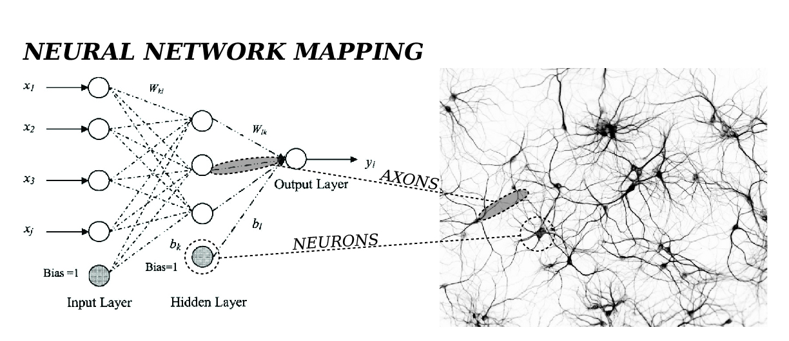
Basics of Neural Networks
Biologically inspired (akin to the neurons in a brain)
http://rpi-cloudreassembly.transvercity.net/2012/11/04/neural-network-mapping-analysis-from-above/

Slide 7
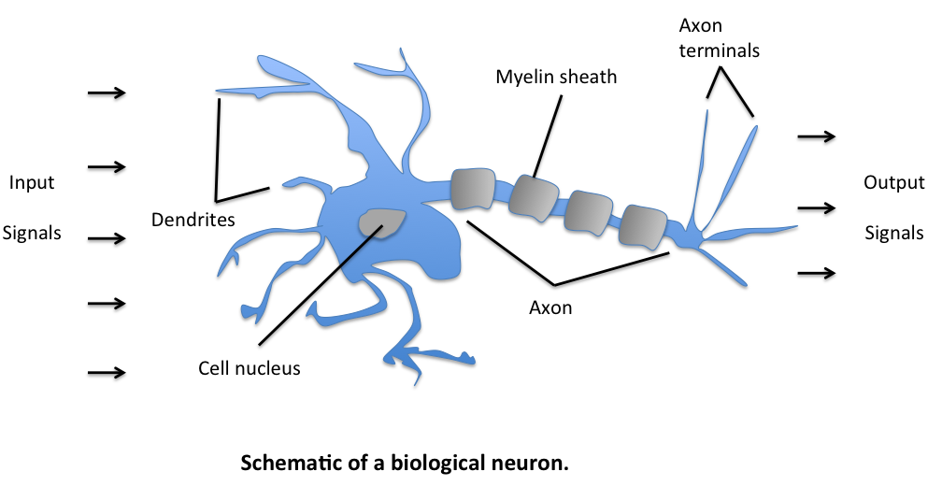
Artificial Neurons and the McCulloch-Pitts Model (1943)
W. S. McCulloch and W. Pitts. A logical calculus of the ideas immanent in nervous activity. The bulletin of mathematical biophysics, 5(4):115–133, 1943.
Notes:
The initial idea of the perceptron dates back to the work of Warren McCulloch and Walter Pitts in 1943 [2], who drew an analogy between biological neurons and simple logic gates with binary outputs. In more intuitive terms, neurons can be understood as the subunits of a neural network in a biological brain. Here, the signals of variable magnitudes arrive at the dendrites. Those input signals are then accumulated in the cell body of the neuron, and if the accumulated signal exceeds a certain threshold, a output signal is generated that which will be passed on by the axon.

Slide 8
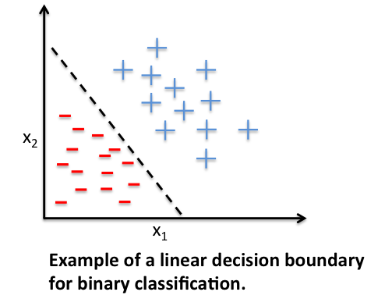
Frank Rosenblatt’s Perceptron (1957)
Supervised learning
Single-layer
Binary linear classifier
To predict to which of 2 possible categories, a certain data point belongs on a set of input variables
F. Rosenblatt. The perceptron, a perceiving and recognizing automaton Project Para. Cornell Aeronautical Laboratory, 1957.
Notes:
To continue with the story, a few years after McCulloch and Walter Pitt, Frank Rosenblatt published the first concept of the Perceptron learning rule [1]. The main idea was to define an algorithm in order to learn the values of the weights ww that are then multiplied with the input features in order to make a decision whether a neuron fires or not. In context of pattern classification, such an algorithm could be useful to determine if a sample belongs to one class or the other.
To put the perceptron algorithm into the broader context of machine learning: The perceptron belongs to the category of supervised learning algorithms, single-layer binary linear classifiers to be more specific. In brief, the task is to predict to which of two possible categories a certain data point belongs based on a set of input variables. In this article, I don’t want to discuss the concept of predictive modeling and classification in too much detail, but if you prefer more background information, please see my previous article “Introduction to supervised learning”.

Slide 9
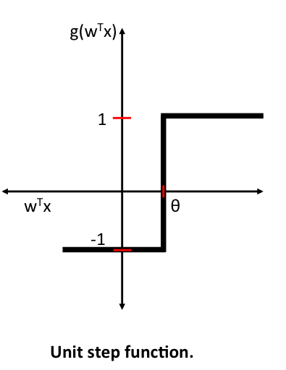
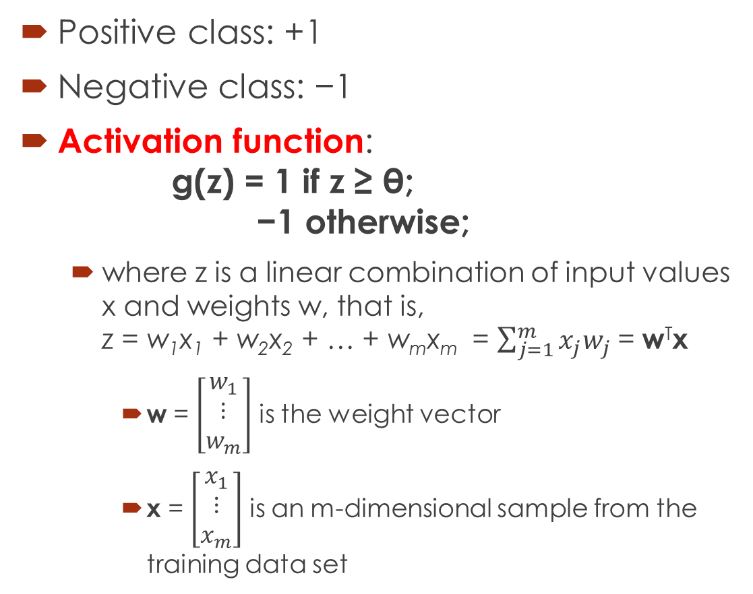
Unit Step Function
Positive class: +1
Negative class: −1
Activation function: g(z) = 1 if z ≥ θ; −1 otherwise;
where z is a linear combination of input values x and weights w, that is, z = w₁x₁ + w₂x₂ + … + w_{m}x_{m} = $\sum_{j=1}^{m}{x_{j}w_{j}}$= w^{T}x
w = $\left[\begin{matrix}w_{1} \\ ⋮ \\ w_{m}\end{matrix}\right]$ is the weight vector
x = $\left[\begin{matrix}x_{1} \\ ⋮ \\ x_{m}\end{matrix}\right]$ is an m-dimensional sample from the training data set
Notes:
Before we dive deeper into the algorithm(s) for learning the weights of the artificial neuron, let us take a brief look at the basic notation. In the following sections, we will label the positive and negative class in our binary classification setting as “1” and “-1”, respectively. Next, we define an activation function g(z)g(z)that takes a linear combination of the input values xx and weights ww as input (z=w1x1+⋯+wmxmz=w1x1+⋯+wmxm), and if g(z)g(z) is greater than a defined threshold θθ we predict 1 and -1 otherwise; in this case, this activation function gg is an alternative form of a simple “unit step function,” which is sometimes also called “Heaviside step function.”
(Please note that the unit step is classically defined as being equal to 0 if z<0z<0 and 1 for z≥0z≥0; nonetheless, we will refer to the following piece-wise linear function with -1 if z<θz<θ and 1 for z≥θz≥θ as unit step function for simplicity).

Slide 10
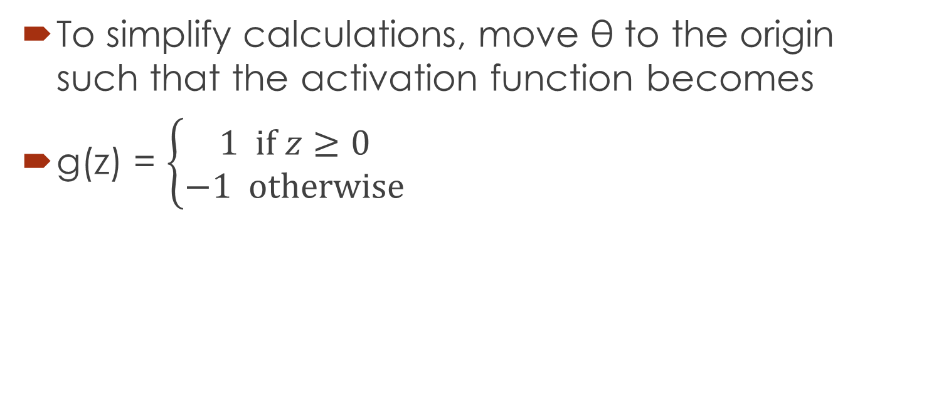
Simplified Unit Step Function
To simplify calculations, move θ to the origin such that the activation function becomes
g(z) = $\left\{\begin{matrix}1 \text{if} z≥0 \\ −1 \text{otherwise}\end{matrix}\right.$

Slide 11
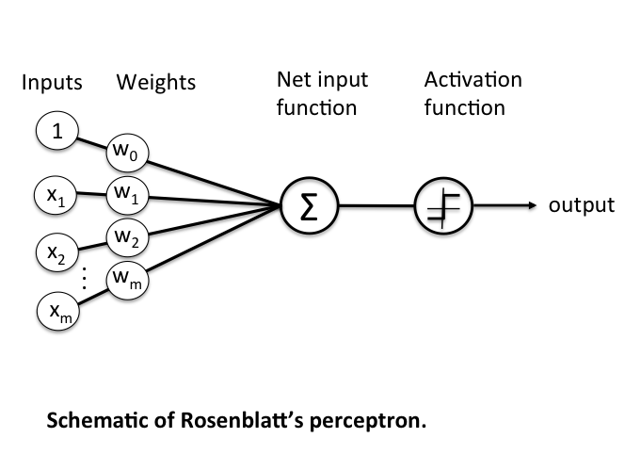
Perceptron Learning Rule
Notes:
What made this a “machine learning” algorithm was Frank Rosenblatt’s idea of the perceptron learning rule: The perceptron algorithm is about learning the weights for the input signals in order to draw linear decision boundary that allows us to discriminate between the two linearly separable classes +1 and -1.

Slide 12
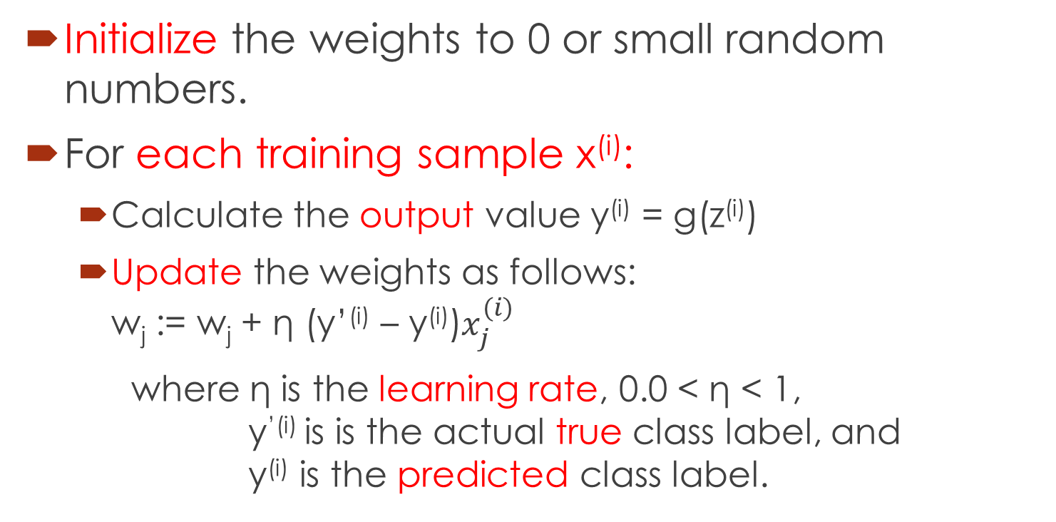
Rosenblatt’s Perceptron Learning Rule
Initialize the weights to 0 or small random numbers.
For each training sample x^{(i)}:
Calculate the output value y^{(i)} = g(z^{(i)})
Update the weights as follows: w_{j} := w_{j} + η (y’^{(i)} – y^{(i)})$x_{j}^{(i)}$
where η is the learning rate, 0.0 < η < 1, y^{’(i)} is is the actual true class label, and y^{(i)} is the predicted class label.
Notes:
Before we implement the perceptron rule in Python, let us make a simple thought experiment to illustrate how beautifully simple this learning rule really is. In the two scenarios where the perceptron predicts the class label correctly, the weights remain unchanged:
Δwj=η(−1(i)−−1(i))x(i)j=0Δwj=η(−1(i)−−1(i))xj(i)=0 Δwj=η(1(i)−1(i))x(i)j=0Δwj=η(1(i)−1(i))xj(i)=0
However, in case of a wrong prediction, the weights are being “pushed” towards the direction of the positive or negative target class, respectively:
Δwj=η(1(i)−−1(i))x(i)j=η(2)x(i)jΔwj=η(1(i)−−1(i))xj(i)=η(2)xj(i) Δwj=η(−1(i)−1(i))x(i)j=η(−2)x(i)jΔwj=η(−1(i)−1(i))xj(i)=η(−2)xj(i)
It is important to note that the convergence of the perceptron is only guaranteed if the two classes are linearly separable. If the two classes can’t be separated by a linear decision boundary, we can set a maximum number of passes over the training dataset (“epochs”) and/or a threshold for the number of tolerated misclassifications.

Slide 13
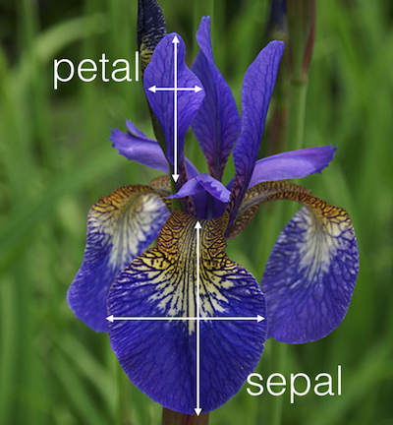
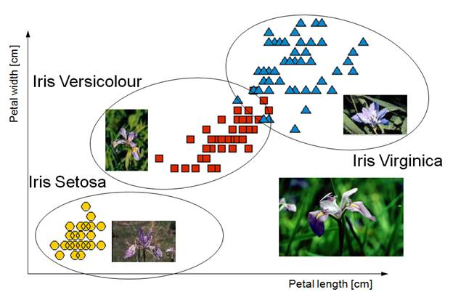
Perceptron Rule in Python: An Example
Classify the flowers in the Iris dataset from UCI Machine Learning Repository using the perceptron rule
Attribute Information:
1. sepal length in cm 2. sepal width in cm 3. petal length in cm 4. petal width in cm 5. class: -- Iris Setosa -- Iris Versicolour -- Iris Virginica

Slide 14
Python Code
import numpy as np
class Perceptron(object):
def __init__(self, eta=0.01, epochs=50):
self.eta = eta
self.epochs = epochs
def train(self, X, y):
self.w_ = np.zeros(1 + X.shape[1])
self.errors_ = []
for _ in range(self.epochs):
errors = 0
for xi, target in zip(X, y):
update = self.eta * (target - self.predict(xi))
self.w_[1:] += update * xi
self.w_[0] += update
errors += int(update != 0.0)
self.errors_.append(errors)
return self
def net_input(self, X):
return np.dot(X, self.w_[1:]) + self.w_[0]
def predict(self, X):
return np.where(self.net_input(X) >= 0.0, 1, -1)
More complete version: https://github.com/rasbt/mlxtend/blob/master/mlxtend/classifier/perceptron.py

Slide 15
Classify 2 flower species: Setosa and Versicolor using sepal length and petal length
import pandas as pd
df = pd.read_csv('https://archive.ics.uci.edu/ml/machine-learning-databases/iris/iris.data', header=None)
# setosa and versicolor
y = df.iloc[0:100, 4].values
y = np.where(y == 'Iris-setosa', -1, 1)
# sepal length and petal length
X = df.iloc[0:100, [0,2]].values

Slide 16
%matplotlib inline
import matplotlib.pyplot as plt
from mlxtend.plotting import plot_decision_regions
ppn = Perceptron(epochs=10, eta=0.1)
ppn.train(X, y)
print('Weights: %s' % ppn.w_)
plot_decision_regions(X, y, clf=ppn)
plt.title('Perceptron')
plt.xlabel('sepal length [cm]')
plt.ylabel('petal length [cm]')
plt.show()
plt.plot(range(1, len(ppn.errors_)+1), ppn.errors_, marker='o')
plt.xlabel('Iterations')
plt.ylabel('Misclassifications')
plt.show()

Slide 17
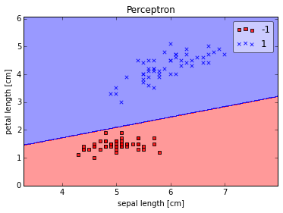
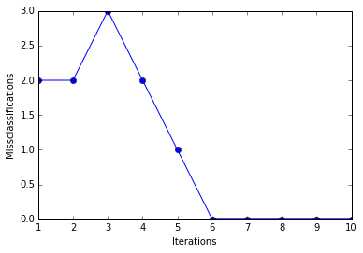
Results
Perceptron converges after 6th iteration
Weights: [-0.4 -0.68 1.82]

Slide 18
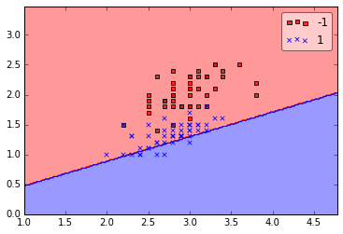
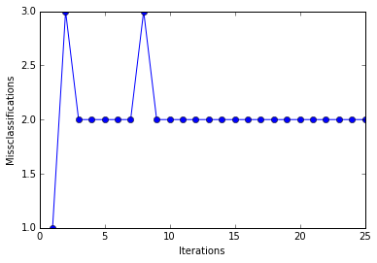
Problems with Perceptron
The 2 classes must be separable by a linear hyperplane
If not, then the perceptron algorithm does NOT converge!
Example
http://sebastianraschka.com/Articles/2015_singlelayer_neurons.html#problems-with-perceptrons

Slide 19
Basics of Neural Networks
The Perceptron and its Learning Rule (Frank Rosenblatt, 1957)
Adaptive Linear Neuron and Delta Rule (Widrow & Hoff, 1960)
Logistic Regression and Gradient Descent

Slide 20
Adaptive Linear Neurons and the Delta Rule (1960)
Bernard Widrow and Tedd Hoff proposed Adaptive Linear Neurons (Adaline)
Linear activation function: g(z) = z.
It is differentiable, so we can define a cost function and minimize it!
B. Widrow et al. Adaptive ”Adaline” neuron using chemical ”memistors”. Number Technical Report 1553-2. Stanford Electron. Labs., Stanford, CA, October 1960.

Slide 21
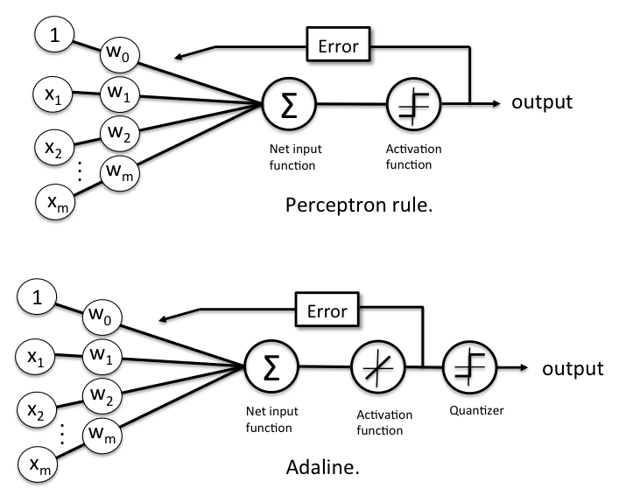

Slide 22
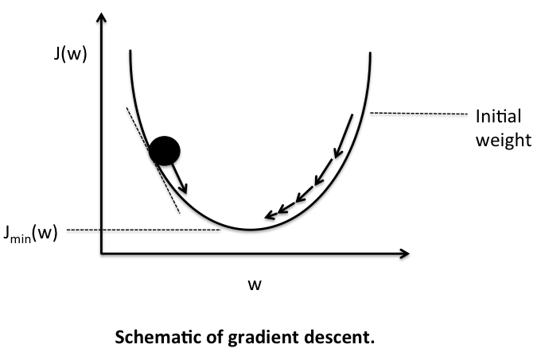
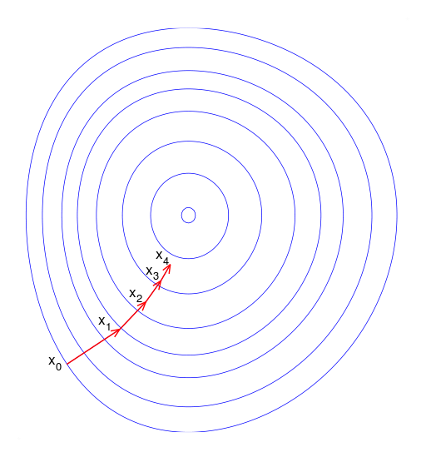
Gradient Descent
Gradient Descent
A first-order iterative optimization algorithm for finding the minimum of a function
Take steps proportional to the negative of the gradient of the function at the current point

Slide 23
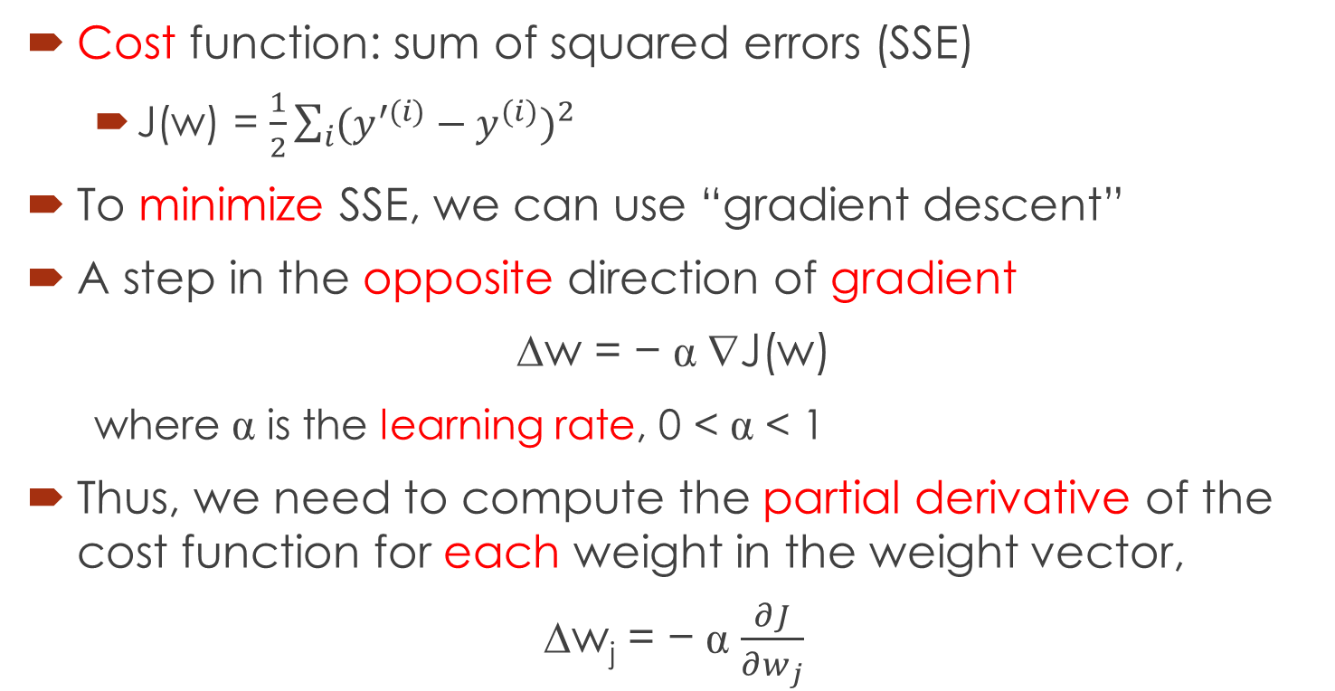
Gradient Descent of a Cost Function
Cost function: sum of squared errors (SSE)
J(w) = $\frac{1}{2}\sum_{i}{{(y^{′(i)}−y^{(i)})}^{2}}$
To minimize SSE, we can use “gradient descent”
A step in the opposite direction of gradient
∆w = − α ∇J(w)
where α is the learning rate, 0 < α < 1
Thus, we need to compute the partial derivative of the cost function for each weight in the weight vector,
∆w_{j} = − α $\frac{∂J}{∂w_{j}}$

Slide 24
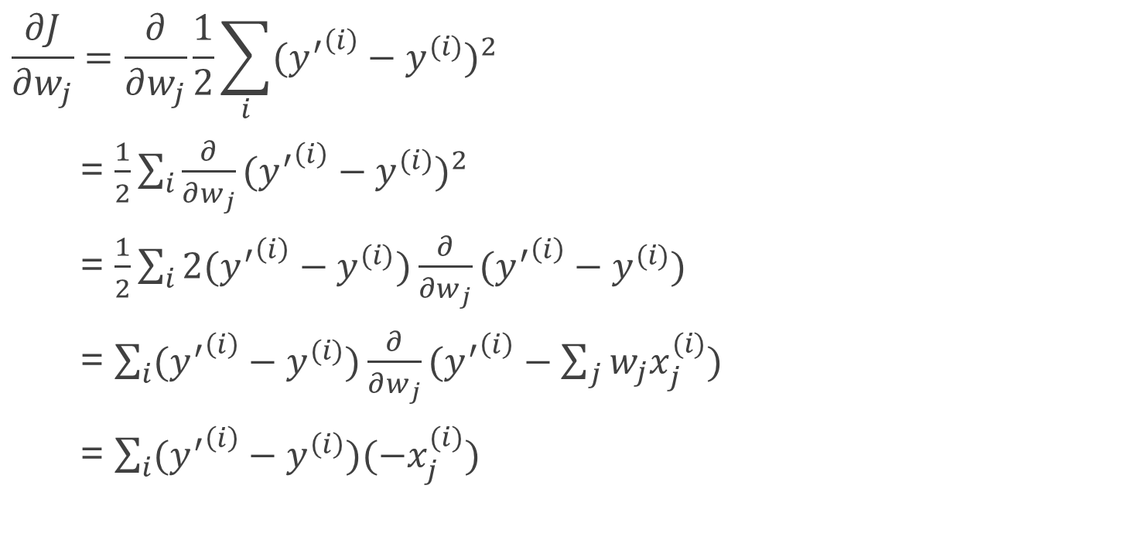
Partial derivative computations
$$\frac{∂J}{∂w_{j}}=\frac{∂}{∂w_{j}}\frac{1}{2}\sum_{i}{{({y^{′}}^{\left(i\right)}−y^{(i)})}^{2}}$$
= $\frac{1}{2}\sum_{i}{{\frac{∂}{∂w_{j}}({y^{′}}^{\left(i\right)}−y^{(i)})}^{2}}$
= $\frac{1}{2}\sum_{i}{2({y^{′}}^{\left(i\right)}−y^{(i)}){\frac{∂}{∂w_{j}}({y^{′}}^{\left(i\right)}−y^{(i)})}^{}}$
= $\sum_{i}{({y^{′}}^{\left(i\right)}−y^{(i)}){\frac{∂}{∂w_{j}}({y^{′}}^{\left(i\right)}−\sum_{j}{w_{j}x_{j}^{(i)}})}^{}}$
= $\sum_{i}{({y^{′}}^{\left(i\right)}−y^{\left(i\right)})(−x_{j}^{(i)})}$

Slide 25
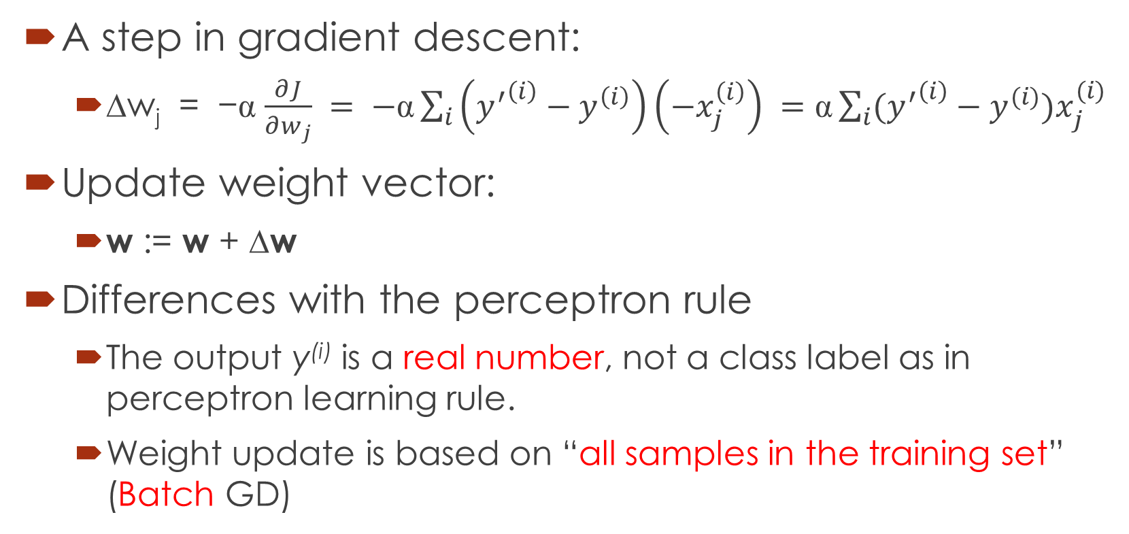
Updating weights using gradient descent
A step in gradient descent:
∆w_{j} = −α $\frac{∂J}{∂w_{j}} = −\text{α}\sum_{i}{\left({y^{′}}^{\left(i\right)}−y^{\left(i\right)}\right)\left(−x_{j}^{\left(i\right)}\right)} =\text{α}\sum_{i}{({y^{′}}^{\left(i\right)}−y^{(i)})x_{j}^{(i)}}$
Update weight vector:
w := w + ∆w
Differences with the perceptron rule
The output y^{(i)} is a real number, not a class label as in perceptron learning rule.
Weight update is based on “all samples in the training set” (Batch GD)

Slide 26
Gradient Descent Rule in Python
import numpy as np class AdalineGD(object): def __init__(self, alpha=0.01, epochs=50): self.alpha = alpha self.epochs = epochs def train(self, X, y): self.w_ = np.zeros(1 + X.shape[1]) self.cost_ = [] for i in range(self.epochs): output = self.net_input(X) errors = (y - output) self.w_[1:] += self.alpha * X.T.dot(errors) self.w_[0] += self.alpha * errors.sum() cost = (errors**2).sum() / 2.0 self.cost_.append(cost) return self | def net_input(self, X): return np.dot(X, self.w_[1:]) + self.w_[0] def activation(self, X): return self.net_input(X) def predict(self, X): return np.where(self.activation(X) >= 0.0, 1, -1)

Slide 27
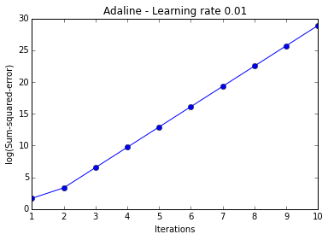
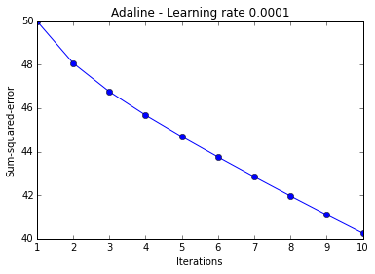
Different Learning Rates: 0.01 vs. 0.0001
ada = AdalineGD(epochs=10, alpha=0.01).train(X, y)
plt.plot(range(1, len(ada.cost_)+1), np.log10(ada.cost_), marker='o')
plt.xlabel('Iterations')
plt.ylabel('log(Sum-squared-error)')
plt.title('Adaline - Learning rate 0.01')
plt.show()
ada = AdalineGD(epochs=10, alpha=0.0001).train(X, y)
plt.plot(range(1, len(ada.cost_)+1), ada.cost_, marker='o')
plt.xlabel('Iterations')
plt.ylabel('Sum-squared-error')
plt.title('Adaline - Learning rate 0.0001')
plt.show()

Slide 28
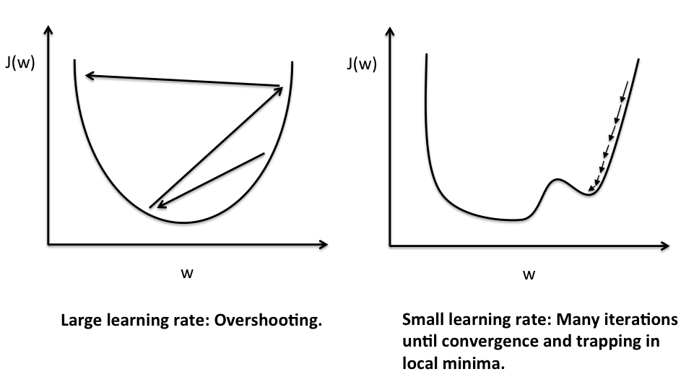
Problems with learning rates
If the learning rate is TOO LARGE, gradient descent will overshoot the minima and diverge.
If the learning rate is too small, gradient descent will require too many epochs to converge and can become trapped in local minima more easily.

Slide 29
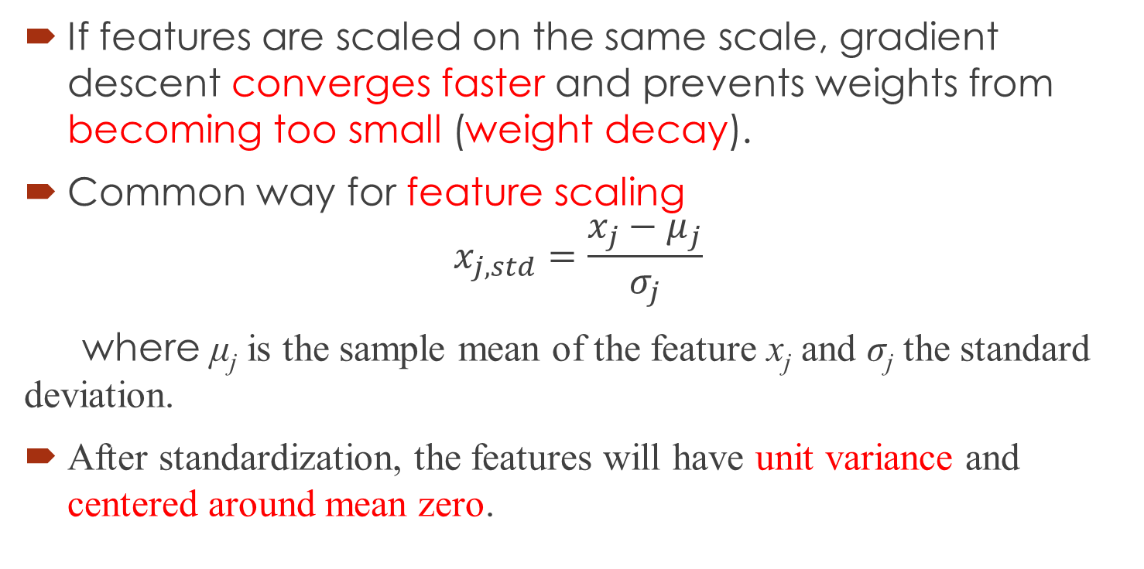
Feature Scaling
If features are scaled on the same scale, gradient descent converges faster and prevents weights from becoming too small (weight decay).
Common way for feature scaling
$$x_{j, std}=\frac{x_{j}−μ_{j}}{σ_{j}}$$
where μ_{j} is the sample mean of the feature x_{j} and σ_{j} the standard deviation.
After standardization, the features will have unit variance and centered around mean zero.

Slide 30
Feature Scaling in Python
# standardize features
X_std = np.copy(X)
X_std[:,0] = (X[:,0] - X[:,0].mean()) / X[:,0].std()
X_std[:,1] = (X[:,1] - X[:,1].mean()) / X[:,1].std()

Slide 31
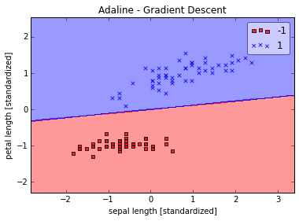
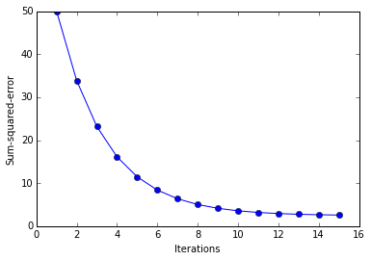
Using feature scaling in Adaline
%matplotlib inline
import matplotlib.pyplot as plt
from mlxtend.plotting import plot_decision_regions
ada = AdalineGD(epochs=15, eta=0.01)
ada.train(X_std, y)
plot_decision_regions(X_std, y, clf=ada)
plt.title('Adaline - Gradient Descent')
plt.xlabel('sepal length [standardized]')
plt.ylabel('petal length [standardized]')
plt.show()
plt.plot(range(1, len( ada.cost_)+1), ada.cost_, marker='o')
plt.xlabel('Iterations')
plt.ylabel('Sum-squared-error')
plt.show()

Slide 32
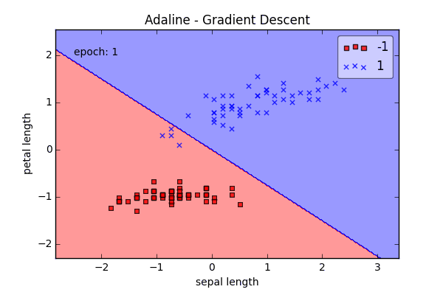
Adaline Gradient Descent

Slide 33
Online Learning via Stochastic Gradient Descent
Batch Gradient Descent (BGD)
Cost function is minimized based on the complete training dataset (all samples)
Stochastic Gradient Descent (SGD)
Weights are incrementally updated after each individual training sample
Converges faster than BGD since weights are updated immediately after each training sample
Computationally more efficient, especially for large datasets
Mini-batch Gradient Descent (MGD)
Compromise between BGD and SGD, dataset is divided into mini-batches
Smoother convergence than SGD

Slide 34
Adaline with SGD in Python
import numpy as np class AdalineSGD(object): def __init__(self, alpha=0.01, epochs=50): self.alpha = alpha self.epochs = epochs def train(self, X, y, reinitialize_weights=True): if reinitialize_weights: self.w_ = np.zeros(1 + X.shape[1]) self.cost_ = [] for i in range(self.epochs): for xi, target in zip(X, y): output = self.net_input(xi) error = (target - output) self.w_[1:] += self.alpha * xi.dot(error) self.w_[0] += self.alpha * error cost = ((y - self.activation(X))**2).sum() / 2.0 self.cost_.append(cost) return self | def net_input(self, X): return np.dot(X, self.w_[1:]) + self.w_[0] def activation(self, X): return self.net_input(X) def predict(self, X): return np.where(self.activation(X) >= 0.0, 1, -1)

Slide 35

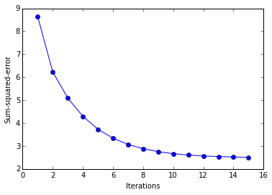
Adaline with SGD Results

Slide 36
Basics of Neural Networks
The Perceptron and its Learning Rule (Frank Rosenblatt, 1957)
Adaptive Linear Neuron and Delta Rule (Widrow & Hoff, 1960)
Logistic Regression and Gradient Descent

Slide 37
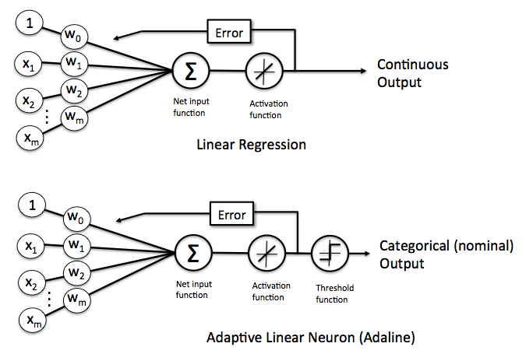
Linear Regression vs. Adaline

Slide 38
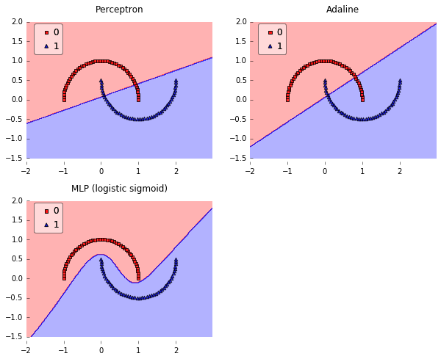
Perceptron vs. Adaline vs. Multi-Layer Perceptrons (Logistic Regression)

Slide 39
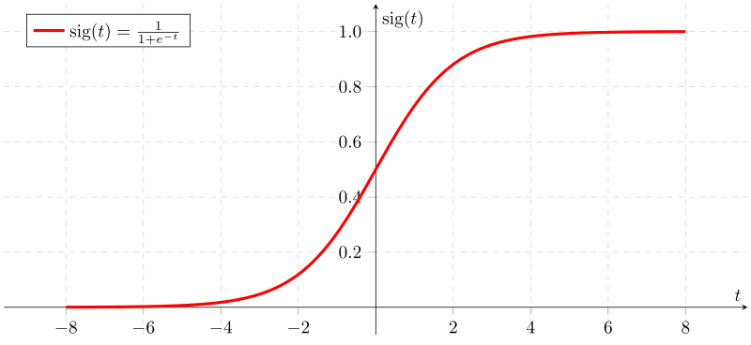
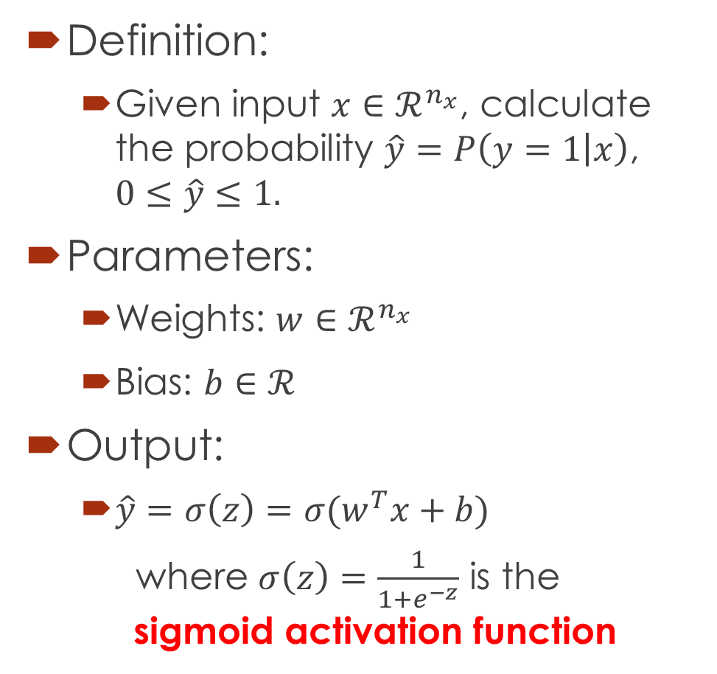
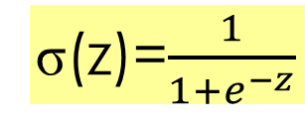
Logistic Regression
Definition:
Given input $x∈ℛ^{n_{x}}$, calculate the probability $\hat{y}=P\left(y=1 | x\right)$, $0≤\hat{y}≤1.$
Parameters:
Weights: $w∈ℛ^{n_{x}}$
Bias: $b∈ℛ^{}$
Output:
$\hat{y}=σ\left(z\right)=σ(w^{T}x+b)$
where $σ\left(z\right)=\frac{1}{1+e^{−z}}$ is the sigmoid activation function
σ(z)=$\frac{1}{1+e^{−z}}$
σ(z)
If z is large positive number, σ(z) → 1
If z is small negative number, σ(z) → 0

Slide 40
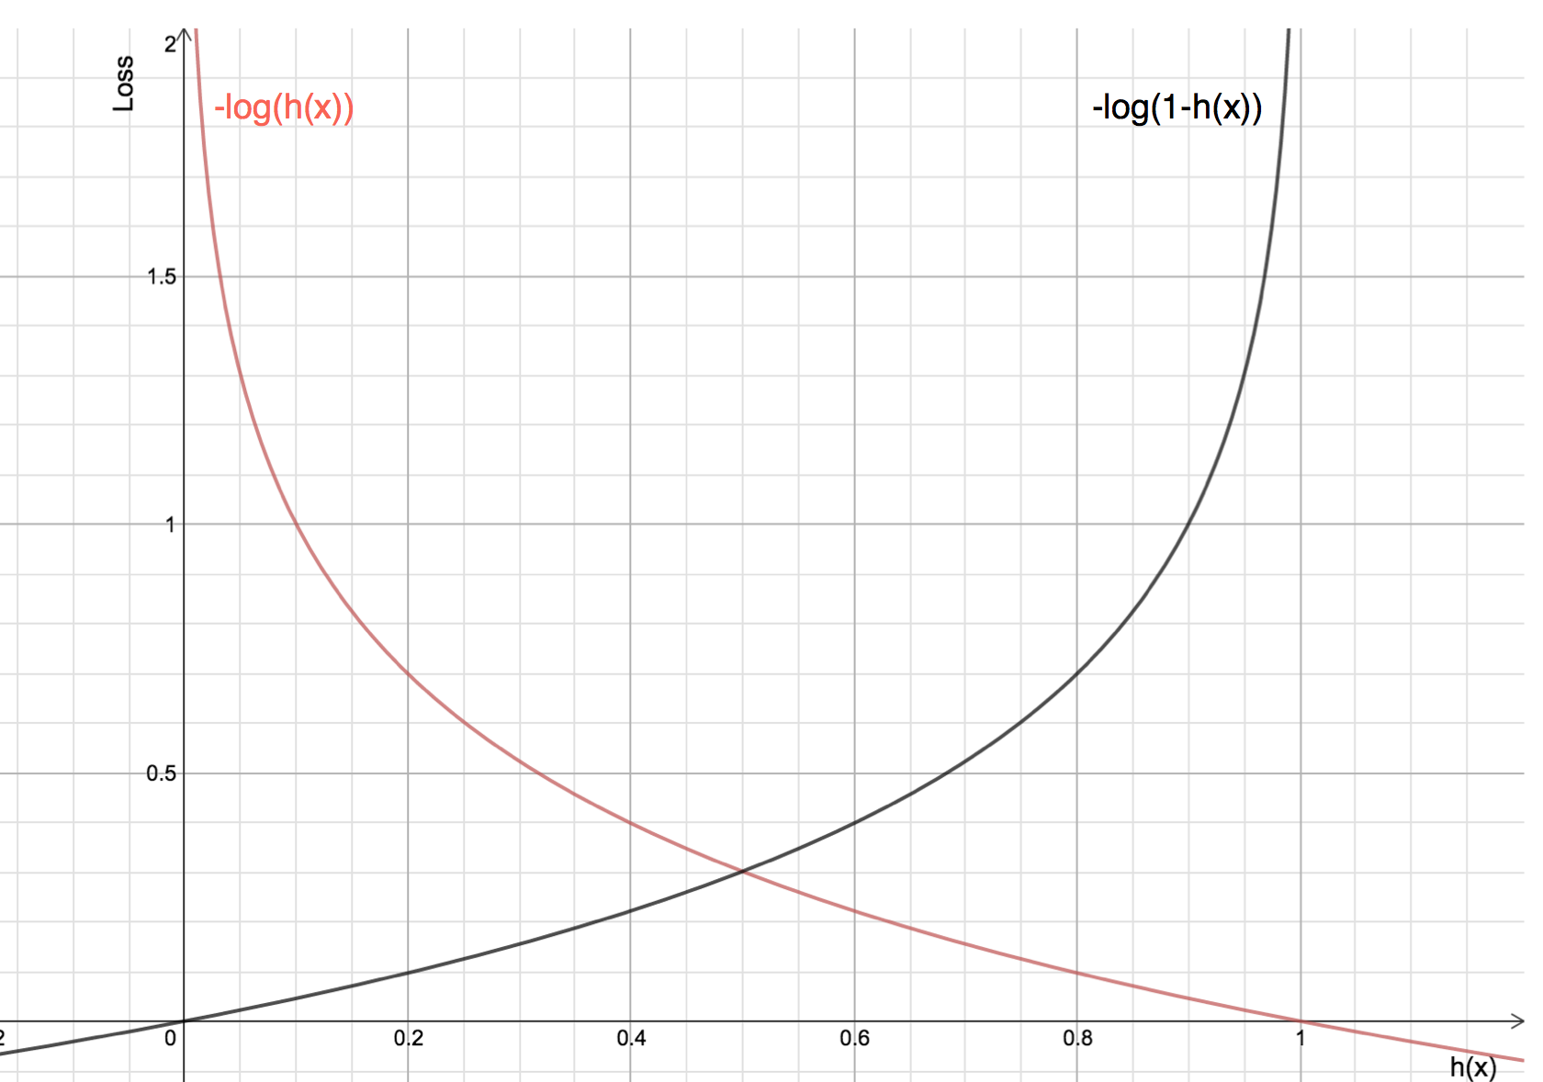
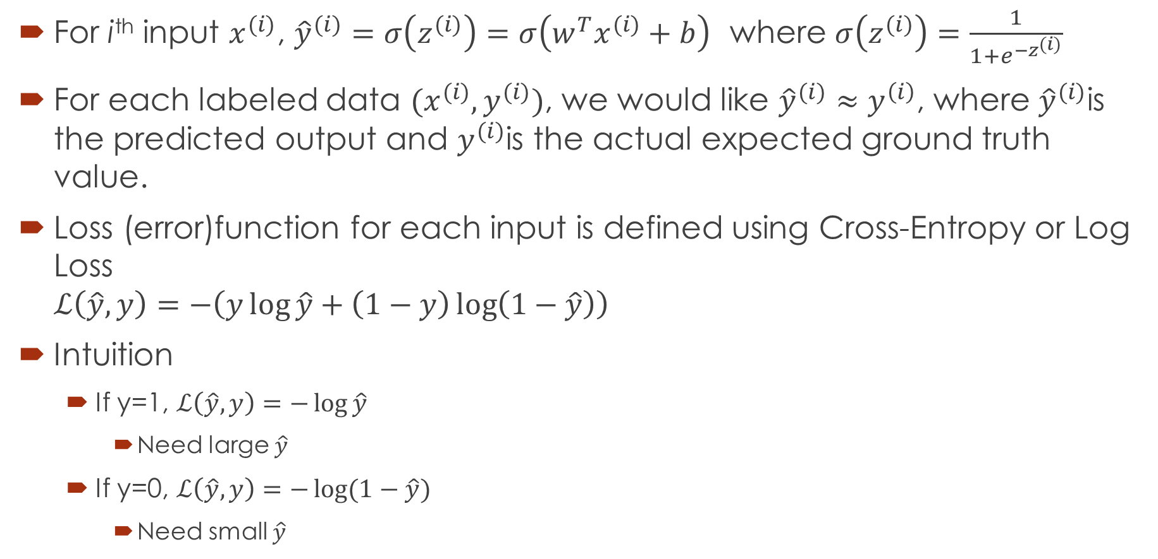
Logistic Regression Cost Function
For i^{th} input $x^{(i)}$, ${\hat{y}}^{(i)}=σ\left(z^{(i)}\right)=σ\left(w^{T}x^{(i)}+b\right)$ where $σ\left(z^{(i)}\right)=\frac{1}{1+e^{−z^{(i)}}}$
For each labeled data $(x^{(i)}, y^{(i)})$, we would like ${\hat{y}}^{(i)}≈y^{\left(i\right)}$, where ${\hat{y}}^{(i)}$is the predicted output and $y^{(i)}$is the actual expected ground truth value.
Loss (error)function for each input is defined using Cross-Entropy or Log Loss $ℒ\left(\hat{y}, y\right)=−\left(y\log{\hat{y}+\left(1−y\right)\log\left(1−\hat{y}\right)}\right)$
Intuition
If y=1, $ℒ\left(\hat{y}, y\right)=−\log{\hat{y}}$
Need large $\hat{y}$
If y=0, $ℒ\left(\hat{y}, y\right)=−\log{(1−\hat{y})}$
Need small $\hat{y}$
Note: we do not use sum of squared errors because it will be not convex in logistic regression

Slide 41
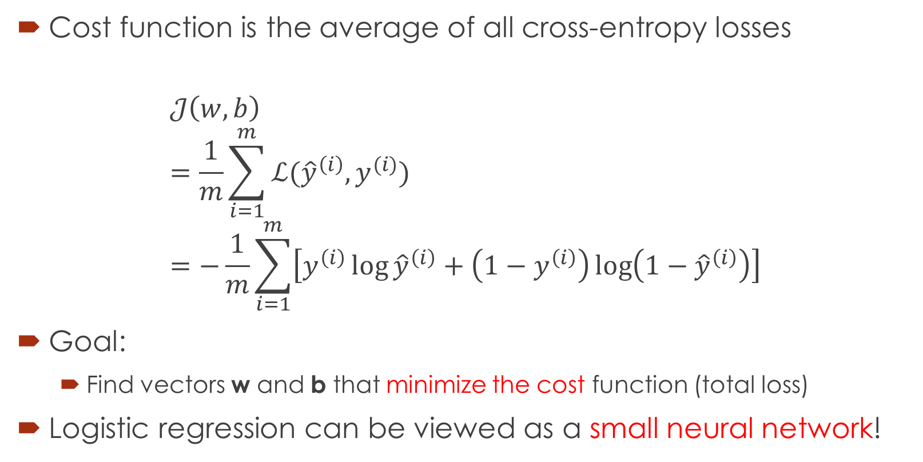
Logistic Regression Cost Function
Cost function is the average of all cross-entropy losses
$$𝒥\left(w,b\right) \\ =\frac{1}{m}\sum_{i=1}^{m}{ℒ({\hat{y}}^{\left(i\right)},y^{(i)})} \\ =−\frac{1}{m}\sum_{i=1}^{m}{\left[y^{\left(i\right)}\log{{\hat{y}}^{\left(i\right)}+\left(1−y^{\left(i\right)}\right)\log\left(1−{\hat{y}}^{\left(i\right)}\right)}\right]}$$
Goal:
Find vectors w and b that minimize the cost function (total loss)
Logistic regression can be viewed as a small neural network!

Slide 42
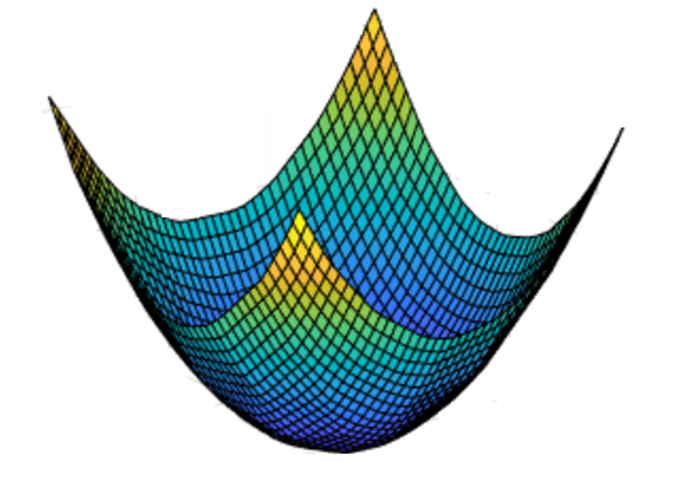
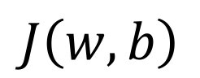
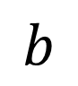
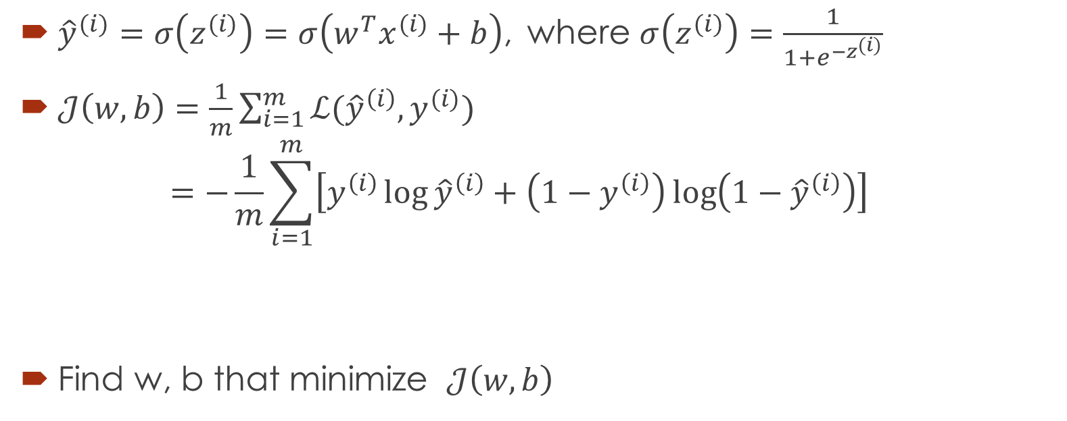

Gradient Descent for Logistic Regression
${\hat{y}}^{(i)}=σ\left(z^{(i)}\right)=σ\left(w^{T}x^{(i)}+b\right)$, where $σ\left(z^{(i)}\right)=\frac{1}{1+e^{−z^{(i)}}}$
$𝒥\left(w,b\right)=\frac{1}{m}\sum_{i=1}^{m}{ℒ({\hat{y}}^{\left(i\right)},y^{(i)})}$ $=−\frac{1}{m}\sum_{i=1}^{m}{\left[y^{\left(i\right)}\log{{\hat{y}}^{\left(i\right)}+\left(1−y^{\left(i\right)}\right)\log\left(1−{\hat{y}}^{\left(i\right)}\right)}\right]}$
Find w, b that minimize $𝒥\left(w,b\right)$
$$J\left(w,b\right)$$
$$b$$
$$w$$
Global Minimum

Slide 43

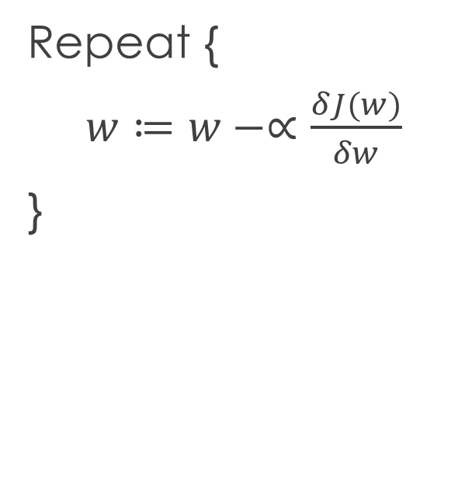
Gradient Descent for Logistic Regression
Repeat {
$w≔w−∝\frac{δJ(w)}{δw}$
}
$$w$$

Slide 44
Computation Graph
A graph that depicts all the computations required for a function in a forward path
For example: J(x, y, z) = 4(x + yz)
Forward Path: Computation
x
y
v = x+u
J = 4v
u = y*z
z
Backward Path: Derivatives

Slide 45
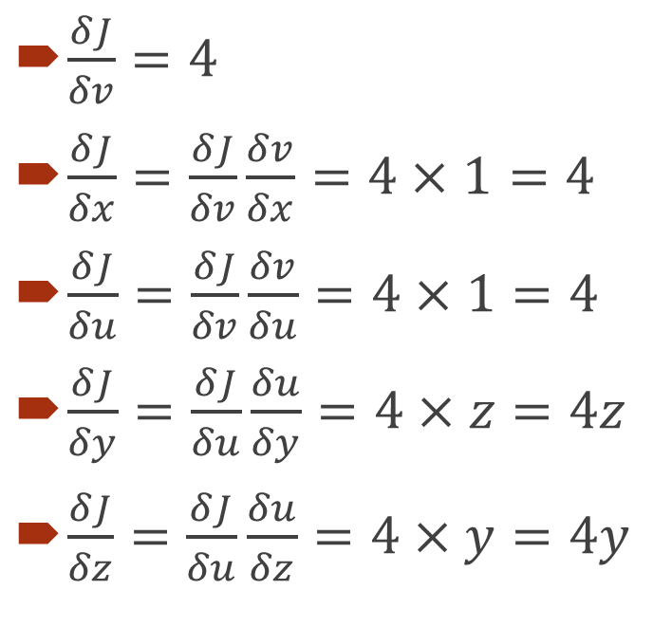
Computing Derivatives
$\frac{δJ}{δv}=4$
$\frac{δJ}{δx}=\frac{δJ}{δv}\frac{δv}{δx}=4×1=4$
$\frac{δJ}{δu}=\frac{δJ}{δv}\frac{δv}{δu}=4×1=4$
$\frac{δJ}{δy}=\frac{δJ}{δu}\frac{δu}{δy}=4×z=4z$
$\frac{δJ}{δz}=\frac{δJ}{δu}\frac{δu}{δz}=4×y=4y$
x
4
y
4z
v = x+u
J = 4v
u = y*z
z
4
4
4y

Slide 46
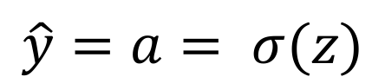
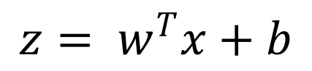
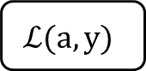
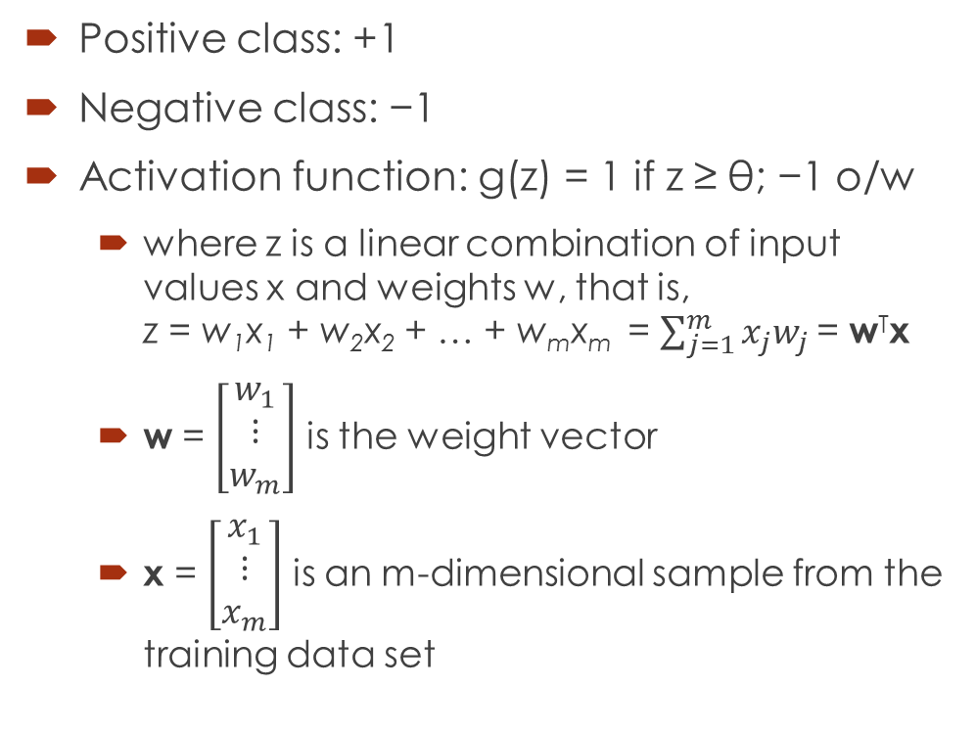
Logistic Regression Computation Graph
$$z= w^{T}x+b$$
$$\hat{y}=a= σ(z)$$
$$ℒ\left(a,y\right)=−(y\log{(a)+(1−y)\log{(1−a))}}$$
x₁
x₂
w₁
z = w₁x₁ + w₂x₂ + b
a = σ(z)
$$ℒ(a, y)$$
w₂
b

Slide 47
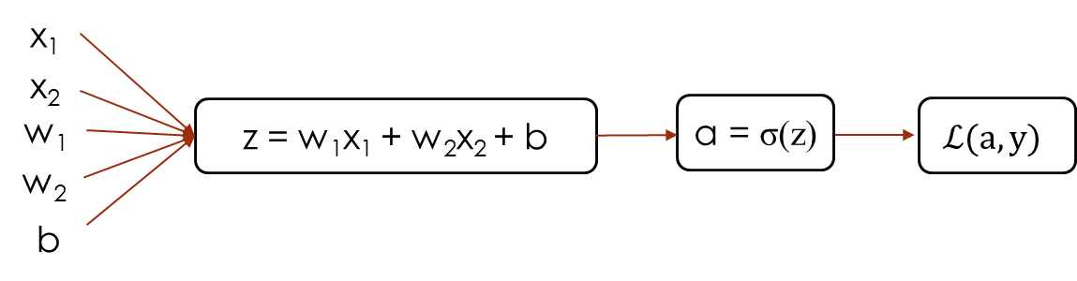
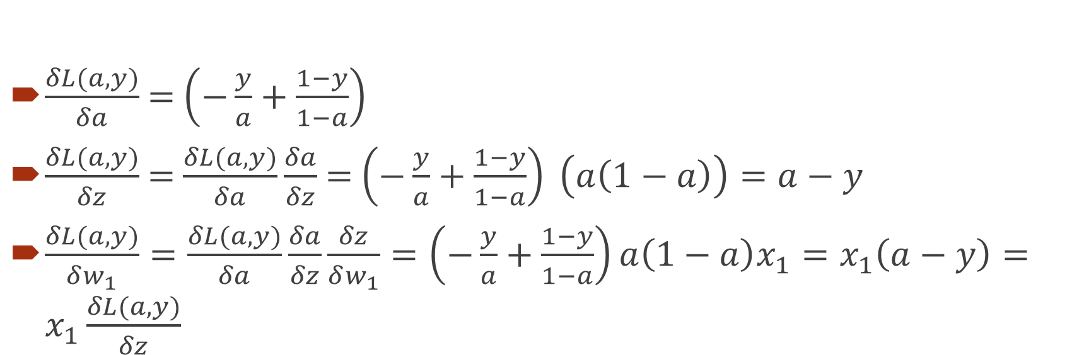
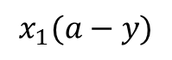
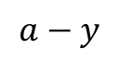

Logistic Regression Derivatives
$$−\frac{y}{a}+\frac{1−y}{1−a}$$
$$x_{1}(a−y)$$
$$a−y$$
$\frac{δL(a,y)}{δa}$ = $\left(−\frac{y}{a}+\frac{1−y}{1−a}\right)$
$\frac{δL(a,y)}{δz}$ = $\frac{δL(a,y)}{δa}\frac{δa}{δz}$ = $\left(−\frac{y}{a}+\frac{1−y}{1−a}\right) \left(a\left(1−a\right)\right)=a−y$
$\frac{δL(a,y)}{δw_{1}}=\frac{δL(a,y)}{δa}\frac{δa}{δz}\frac{δz}{δw_{1}}=\left(−\frac{y}{a}+\frac{1−y}{1−a}\right)a\left(1−a\right)x_{1}=x_{1}\left(a−y\right)=x_{1}\frac{δL(a,y)}{δz}$

Slide 48
Logistic Regression on m examples
J = 0; dw₁ = 0; dw₂ = 0; db = 0;
For i = 1 to m
z^{(i)} = w^{T}x^{(i)} + b
a^{(i)} = σ(z^{(i)})
J += – [y^{(i)} log a^{(i)} + (1 – y^{(i)}) log(1 – a^{(i)})]
dz^{(i)} = a^{(i)} – y^{(i)}
dw₁ += x₁^{(i)} dz^{(i)}
dw₂ += x₁^{(i)} dz^{(i)}
db += dz^{(i)}
J /= m; dw₁ /= m; dw₂ /= m; db /= m;
Update weights:
w₁ := w₁ – α dw₁
w₂ := w₂ – α dw₂
b := b – α db

Slide 49
Vectorization (demo)
import numpy as np
a = np.array([1,2,3,4])
print(a)
import time
a = np.random.rand(1000000)
b = np.random.rand(1000000)
tic = time.time()
c = np.dot(a,b)
toc = time.time()
print(c)
print(“Vectorized version:” + str(1000*(toc-tic) + “ms”)
c = 0
tic = time.time()
for i = range(1000000):
c += a[i]*b[i]
toc = time.time()
print(c)
print(“For loop:” + str(1000*(toc-tic) + “ms”)

Slide 50
Neural network programming guide
Whenever possible, avoid explicit for loops!
Instead of:
u = np.zeros((n,1)) for i in range(n): u[i] = math.exp(v[i])
Use vectors:
u = np.exp(v)
Other functions in numpy: np.log(v), np.abs(v), np.maximum(v,0) Other element-wise computations: v**2, 1/v

Slide 51
Vectorizing Logistic Regression
dw = np.zeros((nx, 1))
J = 0; dw₁ = 0; dw₂ = 0; db = 0;
For i = 1 to m
z^{(i)} = w^{T}x^{(i)} + b
a^{(i)} = σ(z^{(i)})
J += – [y^{(i)} log a^{(i)} + (1 – y^{(i)}) log(1 – a^{(i)})]
dz^{(i)} = a^{(i)} – y^{(i)}
dw₁ += x₁^{(i)} dz^{(i)}
dw₂ += x₁^{(i)} dz^{(i)}
db += dz^{(i)}
J /= m, dw₁ /= m, dw₂ /= m, db /= m
One for loop is thus removed!!!
dw += x^{(i)}dz^{(i)}
dw /= m

Slide 52
Vectorizing Logistic Regression
X = [x⁽¹⁾ x⁽²⁾ … x^{(m)}]
Z = [z⁽¹⁾ z⁽²⁾ … z^{(m)}] = w^{T}X + [b b … b] = np.dot(w.T, X) + b
A = [a⁽¹⁾ a⁽²⁾ … a^{(m)}] = sigmoid(Z)

Slide 53

Vectorizing Gradient Descent
dz⁽¹⁾ = a⁽¹⁾ – y⁽¹⁾, dz⁽²⁾ = a⁽²⁾ – y⁽²⁾, … (all m examples)
dZ = [dz⁽¹⁾ dz⁽²⁾ … dz^{(m)}]
A = [a⁽¹⁾ … a^{(m)}]
Y = [y⁽¹⁾ … y^{(m)}]
dZ = A – Y = [a⁽¹⁾-y⁽¹⁾ … a^{(m)}-y^{(m)}]
db = $\frac{1}{m}\sum_{i=1}^{m}{{dz}^{(i)}}=\frac{1}{m}np.sum\left(dZ\right)$
dw = $\frac{1}{m}X{dZ}^{T}$

Slide 54
Vectorizing Gradient Descent
J = 0; dw = np.zeros((nx,1)); db = 0;
For i = 1 to m
z^{(i)} = w^{T}x^{(i)} + b
a^{(i)} = σ(z^{(i)})
J += – [y^{(i)} log a^{(i)} + (1 – y^{(i)}) log(1 – a^{(i)})]
dz^{(i)} = a^{(i)} – y^{(i)}
dw += x^{(i)} *dz^{(i)}
db += dz^{(i)}
J /= m, dw /= m, db /= m
Z = w^{T}X + b = np.dot(w.T, X) + b
A = sigmoid(Z)
dZ = A – Y
dw = 1/m X dZ^{T}
db = 1/m np.sum(dZ)
w := w – α dw
b := b – α db
Vectorized Version: Without any for loop!

Slide 55
Note on Python/numpy vectors
Don’t use rank 1 arrays of shape (n, )
a = np.random.randn(5)
print(a)
[ 0.50290632 -0.2 …]
print(a.shape)
(5, )
Use column vectors of shape (n, 1) or row vectors of shape (1, n)
a = np.random.randn(5,1)

Slide 56
Contents
Basics of Neural Networks
Shallow Neural Networks
Deep Neural Networks

Slide 57











What is a Shallow Neural Network?
$$x_{1}$$
Single neuron model
$$x_{2}$$
$$\hat{y}$$
x
$$x_{3}$$
Multiple layer neural model
w
$$z=w^{T}x+b$$
$$a=σ(z)$$
$$ℒ(a,y)$$
$$x_{1}$$
b
Computation graph
$$x_{2}$$
$$\hat{y}$$
$$x_{3}$$
x
$$W^{[1]}$$
$$z^{[1]}=W^{[1]}x+b^{[1]}$$
$$a^{[1]}=σ(z^{[1]})$$
$$z^{[2]}=W^{[2]}a_{ }^{[1]}+b^{[2]}$$
$$a^{[2]}=σ(z^{[2]})$$
$$b^{[1]}$$
$$ℒ(a^{[2]},y)$$
Computation graph

Slide 58







One hidden layer Neural Network
2-layer NN
Layer 1
$$a_{1}^{[1]}$$
$$x_{1}$$
$$a_{0}=X$$
$$a_{2}^{[1]}$$
Layer 2
$$x_{2}$$
$$\hat{y}$$
$$a_{3}^{[1]}$$
$${=a}_{}^{[2]}$$
$$x_{3}$$
$$a_{4}^{[1]}$$
$$a^{[1]}=\left[\begin{matrix}\begin{matrix}a_{1}^{[1]} \\ a_{2}^{[1]}\end{matrix} \\ \begin{matrix}a_{3}^{[1]} \\ a_{4}^{[1]}\end{matrix}\end{matrix}\right]$$
Input layer
Hidden layer
Output layer

Slide 59



Computing NN’s Output
$$x_{1}$$
$$x_{2}$$
$$w^{T}x+b$$
$$a=\hat{y}$$
$$σ(z)$$
$$z$$
$$a$$
$$x_{3}$$
$$z=w^{T}x+b$$
$$a=σ(z)$$

Slide 60








Computing NN’s Output
$$a_{1}^{\left[1\right]}$$
$z_{1}^{\left[1\right]}=w_{1}^{{\left[1\right]T}^{ }}x+b_{1}^{[1]}, a_{ 1}^{[1]}=σ(z_{1}^{\left[1\right]}$)
$$x_{1}$$
$$a_{2}^{\left[1\right]}$$
$z_{2}^{\left[1\right]}=w_{2}^{{\left[1\right]T}^{ }}x+b_{2}^{[1]}, a_{ 2}^{[1]}=σ(z_{2}^{\left[1\right]}$)
$$x_{2}$$
$$\hat{y}$$
$$a_{3}^{\left[1\right]}$$
$z_{3}^{\left[1\right]}=w_{3}^{{\left[1\right]T}^{ }}x+b_{3}^{[1]}, a_{ 3}^{[1]}=σ(z_{3}^{\left[1\right]}$)
$$x_{3}$$
$$a_{4}^{\left[1\right]}$$
$z_{4}^{\left[1\right]}=w_{4}^{{\left[1\right]T}^{ }}x+b_{4}^{[1]}, a_{ 4}^{[1]}=σ(z_{4}^{\left[1\right]}$)
Given input x:
$$z^{\left[1\right]}=W^{\left[1\right]}x+b^{\left[1\right]}$$
$$z^{\left[2\right]}=W^{\left[2\right]}a^{\left[1\right]}+b^{\left[2\right]}$$
$$a^{\left[1\right]}=σ(z^{\left[1\right]})$$
$$a^{\left[2\right]}=σ(z^{\left[2\right]})$$

Slide 61




Vectorizing across multiple examples
For all m examples …
$$a_{1}^{\left[1\right]}$$
for i = 1 to m:
$$x_{1}$$
$$z^{\left[1\right](i)}=W^{\left[1\right]}x^{(i)}+b^{\left[1\right]}$$
$$a_{2}^{\left[1\right]}$$
$$x_{2}$$
$$a^{\left[1\right](i)}=σ(z^{\left[1\right]\left(i\right)})$$
$$\hat{y}$$
$$a_{3}^{\left[1\right]}$$
$$z^{\left[2\right](i)}=W^{\left[2\right]}a^{\left[1\right](i)}+b^{\left[2\right]}$$
$$x_{3}$$
$$a_{4}^{\left[1\right]}$$
$$a^{\left[2\right](i)}=σ(z^{\left[2\right]\left(i\right)})$$

Slide 62




Vectorizing across multiple examples
for i = 1 to m:
$$z^{\left[1\right](i)}=W^{\left[1\right]}x^{(i)}+b^{\left[1\right]}$$
$$a^{\left[1\right](i)}=σ(z^{\left[1\right]\left(i\right)})$$
$$X=$$
$$z^{\left[2\right](i)}=W^{\left[2\right]}a^{\left[1\right](i)}+b^{\left[2\right]}$$
$$x^{(1)}$$
$$x^{(2)}$$
…
$$x^{(m)}$$
$$a^{\left[2\right](i)}=σ(z^{\left[2\right]\left(i\right)})$$
$$Z^{\left[1\right]}=W^{\left[1\right]}X+b^{\left[1\right]}$$
$A^{[1]}=$
$$A^{\left[1\right]}=σ(Z^{\left[1\right]})$$
$$a^{[1](1)}$$
$$a^{[1](2)}$$
$$a^{[1](m)}$$
…
$$Z^{\left[2\right]}=W^{\left[2\right]}A^{\left[1\right]}+b^{\left[2\right]}$$
$$A^{\left[2\right]}=σ(Z^{\left[2\right]})$$

Slide 63

Activation functions can be …
Comprehensive List of Activation Functions: https://stats.stackexchange.com/questions/115258/comprehensive-list-of-activation-functions-in-neural-networks-with-pros-cons

Slide 64

REctified Linear Unit (RELU)
Currently, most popular activation function
Gradient descent is much faster with ReLU

Slide 65


Derivatives of Activation Functions
a
Activation Function | Formula (g(z)) | Derivative (g’z))
sigmoid | $$a=\frac{1}{1+e^{−z}}$$ | $$a(1−a)$$
tanh | $$a=\frac{e^{z}−e^{−z}}{e^{z}+e^{−z}}$$ | $$1−a^{2}$$
ReLU | $$\max_{}{(0,z)}$$ | $$\begin{matrix}0 \text{i}\text{f} z<0 \\ 1 \text{if} z≥0\end{matrix}$$
Leaky ReLU | $$\max_{}{(0.01z,z)}$$ | $$\begin{matrix}0.01 \text{i}\text{f} z<0 \\ 1 \text{if} z≥0\end{matrix}$$
sigmoid
z
a
tanh
z
a
ReLU
z
Leaky ReLU
a
z

Slide 66
Why non-linear activation function?
$$x_{1}$$
What not linear?
Suppose g^{[1]}, g^{[2]} are all linear
a^{[1]} = z^{[1]}
a^{[2]} = z^{[2]}
a^{[2]} = W^{[2]}a^{[1]}+b^{[2]}
= W^{[2]}(W^{[1]}X+b^{[1]})+b^{[2]}
= W^{[2]}W^{[1]}X + W^{[2]}b^{[1]}+b^{[2]}
= W’X + b’
All LINEAR!!!
$$x_{2}$$
$$\hat{y}$$
$$x_{3}$$
Given x:
$$z^{\left[1\right]}=W^{\left[1\right]}x+b^{\left[1\right]}$$
$$a^{\left[1\right]}=g^{[1]}(z^{\left[1\right]})$$
$$z^{\left[2\right]}=W^{\left[2\right]}a^{\left[1\right]}+b^{\left[2\right]}$$
$$a^{\left[2\right]}=g^{[2]}(z^{\left[2\right]})$$

Slide 67















Gradient descent for one hidden layer neural network
$$W^{[2]}$$
$$x$$
$$b^{[2]}$$
$$W^{[1]}$$
$$z^{[1]}=W^{[1]}x+b^{[1]}$$
$$a^{[1]}= σ(z^{[1]})$$
$$z^{[2]}=W^{[2]}x+b^{[2]}$$
$$a^{[2]}= σ(z^{[2]})$$
$$ℒ(a^{[2]},y)$$
$$b^{[1]}$$
$$dz^{[1]}=W^{\left[2\right]T}dz^{[2]}∗g^{[1]}′(z^{\left[1\right]})$$
$$dz^{[2]}=a^{[2]}−y$$
$$dW^{[2]}=dz^{[2]}a^{{\left[1\right]}^{T}}$$
$$dW^{[1]}=dz^{[1]}x^{T}$$
$$db^{[1]}=dz^{[1]}$$
$$db^{[2]}=dz^{[2]}$$

Slide 68









Vectorizing Gradient Descent (over m examples)
$$dz^{[2]}=a^{[2]}−y$$
$$dZ^{[2]}=A^{[2]}−Y$$
$$J\left(..\right)=\frac{1}{m}\sum_{i=1}^{m}{ℒ(\hat{y},y)}$$
$$dW^{[2]}=dz^{[2]}a^{{\left[1\right]}^{T}}$$
$$dW^{[2]}=\frac{1}{m}dZ^{[2]}A^{{\left[1\right]}^{T}}$$
$$db^{[2]}=dz^{[2]}$$
$$db^{[2]}=\frac{1}{m}np.sum(dZ^{\left[2\right]},axis=1, keepdims=True)$$
$$dz^{[1]}=W^{\left[2\right]T}dz^{[2]}∗g^{[1]}′(z^{\left[1\right]})$$
$$dZ^{[1]}=W^{\left[2\right]T}dZ^{[2]}∗g^{[1]}′(Z^{\left[1\right]})$$
$$dW^{[1]}=dz^{[1]}x^{T}$$
$$dW^{[1]}=\frac{1}{m}dZ^{[1]}X^{T}$$
$$db^{[1]}=dz^{[1]}$$
$$db^{[1]}=\frac{1}{m}np.sum(dZ^{\left[1\right]},axis=1, keepdims=True)$$

Slide 69



Initializing weights
Why are weights not initialized to zero?
Suppose all weights are zero:
W^{[1]} = $\left[\begin{matrix}0 & 0 \\ 0 & 0\end{matrix}\right]$
b^{[1]} =$\left[\begin{matrix}0 \\ 0\end{matrix}\right]$
$a_{1}^{[1]}=a_{2}^{[1]}$
${dz}_{1}^{[1]}={dz}_{2}^{[1]}$
$dW=\left[\begin{matrix}u & v \\ u & v\end{matrix}\right]$ (i.e., symmetric rows)
$W^{[1]}=W^{[1]}−αdW$
$W^{[1]}=\left[\begin{matrix}f & g \\ f & g\end{matrix}\right]$ (i.e., symmetric rows)
No need of TWO or more neurons … because all computations are same!
Do NOT initialize all weights are ZERO!!
$$x_{1}$$
$$a_{1}^{[1]}$$
$$a_{1}^{[2]}$$
$$\hat{y}$$
$$x_{2}$$
$$a_{2}^{[1]}$$

Slide 70
Initialize weights RANDOMLY!
W[1] = np.random.randn((2,2))*0.01
Small random values are suggested!
If too large, Z^{[1]} = W^{[1]}X + b^{[1]} will also be very large and a^{[1]} = g^{[1]}(z^{[1]}) will be in the flat areas and gradient descent will be very, very slooooooooow….
b[1] = np.zero((2,1)) (b can be zero, no problem!)
a
sigmoid
z

Slide 71
Contents
Basics of Neural Networks
Shallow Neural Networks
Deep Neural Networks

Slide 72
Neural Networks: 1-layer, 2-layers, …
$$x_{1}$$
$$x_{1}$$
$$x_{2}$$
$$\hat{y}$$
$$x_{2}$$
$$\hat{y}$$
$$x_{3}$$
$$x_{3}$$
1-layer
2-layers
$$x_{1}$$
$$\hat{y}$$
$$x_{2}$$
5-layers

Slide 73

Notations in Deep Neural Networks
#Layers = $L$ = 5
$n^{[l]}$ = #units in layer $l$
$n^{[1]}$ = 3, $n^{[2]}$ = 5, $n^{[3]}$ = 4, $n^{[4]}$ = 2, $n^{[5]}$ = $n^{[L]}$ = 1
$n^{[0]}$ =$n^{[x]}$ = 2
$a^{[l]}=g^{\left[l\right]}(z^{[l]})$
$W^{[l]}$ = weights for computing $z^{[l]}$
$b^{[l]}$ = bias for computing $z^{[l]}$
$a^{[0]}$ = $X$ (input)
$a^{[L]}$ = $\hat{y}$ (prediction output)
$$x_{1}$$
$$\hat{y}$$
$$x_{2}$$

Slide 74





Forward Propagation in Deep Neural Network (Vectorized Version over all m examples)
$$Z^{\left[1\right]}=W^{\left[1\right]}X+b^{\left[1\right]}$$
$$A^{\left[1\right]}=g^{[1]}(Z^{\left[1\right]})$$
$$x_{1}$$
$$Z^{\left[2\right]}=W^{\left[2\right]}A^{\left[1\right]}+b^{\left[2\right]}$$
$$\hat{y}$$
$$x_{2}$$
$$A^{\left[2\right]}=g^{[2]}(Z^{\left[2\right]})$$
…
$${\hat{Y}=A}^{\left[L\right]}=g^{[L]}(Z^{\left[L\right]})$$
$$Z^{\left[l\right]}=W^{\left[l\right]}A^{[l−1]}+b^{\left[l\right]}$$
$$A^{\left[l\right]}=g^{[l]}(Z^{\left[l\right]})$$
Still need a “for” loop over all layers 1 to L

Slide 75


Getting your matrix dimensions correct
$L=5$
$n^{[1]}$ = 3, $n^{[2]}$ = 5, $n^{[3]}$ = 4, $n^{[4]}$ = 2, $n^{[5]}$ = $n^{[L]}$ = 1
(3, 1) = (?, ?) x (2, 1) + (3, 1)
(n^{[1]}, 1) = (n^{[1]}, n^{[0]}) x (n^{[0]}, 1)
Thus, dim of W^{[1]} is (n^{[1]}, n^{[0]})
Similarly, dim of W^{[2]} is (n^{[2]}, n^{[1]})
In this example, dim of W^{[2]} is (5, 3)
Thus, dim of $W^{[l]}$ is $\left(n^{\left[l\right]}, n^{\left[l−1\right]}\right)$
and dim of $b^{[l]}$ is $(n^{[l]}, 1)$
$$z^{\left[1\right]}=W^{\left[1\right]}x+b^{\left[1\right]}$$
$$x_{1}$$
$$\hat{y}$$
$$x_{2}$$
W[3]:
W[4]:
W[5]:
(4, 5)
(2, 4)
(1, 2)

Slide 76


Dimensions of vectorized implementations
For one single training example:
$z^{[l]}=W^{[l]}a^{[l−1]}+b^{[l]}$
$\left(n^{\left[l\right]},1\right)=\left(n^{\left[l\right]},n^{\left[l−1\right]}\right)×\left(n^{\left[l−1\right]},1\right)+{(n}^{[l]},1)$
For a vectorized implementation over m examples
$Z^{[l]}=W^{[l]}A^{[l−1]}+b^{[l]}$
$\left(n^{\left[l\right]},m\right)=\left(n^{\left[l\right]},n^{\left[l−1\right]}\right)×\left(n^{\left[l−1\right]},m\right)+{(n}^{[l]},m)$
Matrix | Dimensions
$Z^{[l]}, A^{[l]}$, ${b^{[l]},dZ}^{[l]}, {dA}^{[l]},{db}^{[l]}$ | $${(n}^{[l]},m)$$
$$W^{[l]},{dW}^{[l]}$$ | $$\left(n^{\left[l\right]},n^{\left[l−1\right]}\right)$$

Slide 77



Why deep networks?
$$\hat{y}$$

Slide 78
Why deep networks?
256 neurons in 1 layer
To check even parity of an 8-bit
Using 3 layers of XOR gates is much simple
Using 2⁸ = 256 choices would be much more complex
x₁
x₂
x₃
x₄
x₅
P
x₆
…
x₇
…
x₈

Slide 79











Building Blocks of Deep Neural Networks
$$x_{1}$$
$$x_{2}$$
$$\hat{y}$$
$$x_{3}$$
$$x_{4}$$
layer $l$
Focus on some layer $l$, parameters include $W^{[l]}$, $b^{[l]}$
Forward Propagation
Input: $a^{[l−1]}$
Output: $a^{[l]}$
Method: $z^{[l]}=W^{[l]}a^{[l−1]}+b^{[l]}$, $a^{[l]}=g^{\left[l\right]}(z^{[l]})$
Cache: $z^{[l]}$
$$a^{[l]}$$
$$a^{[l−1]}$$
$$W^{[l]}, b^{[l]}$$
Cache: $z^{[l]}$
$$W^{[l]}, b^{[l]}$$
$${(dz}^{[l]})$$
$${da}^{[l]}$$
$${da}^{[l−1]}$$
Backward Propagation
Input: ${da}^{[l]}$, $z^{[l]}$ (from cache)
Output: ${da}^{[l−1]}$, ${dW}^{[l]}, {db}^{[l]}$
$${dW}^{[l]}, {db}^{[l]}$$

Slide 80






















Forward and backward functions
$$a^{[1]}$$
$$a^{[2]}$$
…
$$a^{[L−1]}$$
$$a^{[L]}=\hat{y}$$
$$a^{[0]}$$
$$W^{[1]}, b^{[1]}$$
$$W^{[2]}, b^{[2]}$$
$$W^{[L]}, b^{[L]}$$
Cache: $z^{[1]}$
$$z^{[2]}$$
$$z^{[L]}$$
$${da}^{[1]}$$
$${da}^{[2]}$$
…
$${da}^{[L−1]}$$
$$W^{[L]}, b^{[L]}$$
$${(dz}^{[L]})$$
$${da}^{[L]}$$
$$W^{[1]}, b^{[1]}$$
$${(dz}^{[1]})$$
$$W^{[2]}, b^{[2]}$$
$${(dz}^{[2]})$$
$${dW}^{[1]}, {db}^{[1]}$$
$${dW}^{[2]}, {db}^{[2]}$$
$${dW}^{[L]}, {db}^{[L]}$$
$$W^{[l]}=W^{[l]}−α{dW}^{\left[l\right]}$$
$$b^{[l]}=b^{[l]}−α{db}^{\left[l\right]}$$

Slide 81

Forward Propagation for DNN
Input: $a^{[l−1]}$
Forward Propagation:
For single example:
$z^{[l]}=W^{[l]}a^{[l−1]}+b^{[l]}$, $a^{[l]}=g^{\left[l\right]}(z^{[l]})$
Vectorized version:
$Z^{[l]}=W^{[l]}A^{[l−1]}+b^{[l]}$, $A^{[l]}=g^{\left[l\right]}(Z^{[l]})$
Output: $a^{[l]}$
Cache: $z^{[l]}, W^{[l]}, b^{[l]}$

Slide 82


Backward Propagation for DNN
Inputs: ${da}^{[l]}$, $z^{[l]}, W^{[l]}, b^{[l]}$ (last 3 from cache)
Outputs: ${da}^{[l−1]}$, ${dW}^{[l]}, {db}^{[l]}$
Backward Propagation:
For single example
$${dz}^{[l]}={da}^{[l]}∗g^{{\left[l\right]}^{′}}\left(z^{\left[l\right]}\right)$$
$${dW}^{[l]}={dz}^{[l]}.a^{[l−1]}$$
$${db}^{[l]}={dz}^{[l]}$$
$${da}^{[l−1]}=W^{\left[l\right]T}{dz}^{[l]}$$
$${dz}^{[l]}=W^{\left[l+1\right]T}{dz}^{[l+1]}∗g^{{\left[l\right]}^{′}}(z^{[l]})$$
Vectorized implementation
$${dZ}^{[l]}={dA}^{[l]}∗g^{{\left[l\right]}^{′}}\left(Z^{\left[l\right]}\right)$$
$${dW}^{[l]}={\frac{1}{m}dZ}^{[l]}.A^{\left[l−1\right]T}$$
$${db}^{[l]}={\frac{1}{m}np.sum(dZ}^{[l]},axis=1,keepdims=True)$$
$${dA}^{[l−1]}=W^{\left[l\right]T}{dZ}^{[l]}$$

Slide 83

Parameters vs. Hyperparameters
Parameters: $W^{[1]}, b^{[1]},W^{[2]}, b^{[2]}, …$
Hyperparameters
Learning rate: $α$
Number of iterations
Number of hidden layers or L
Number of hidden units in each layer: $n^{[1]}, n^{[2]}, …$
Choice of activation function: sigmoid, ReLU, tanh, etc.
Momentum, mini-batch size, regularization parameters, … (in the next Chapter)

Slide 84


Empirical Process in Applied DL
Idea
cost $J$
best $α$
Experiment
Code
# of iterations

Slide 85












Summary of Forward/Backward Computations
$$Z^{[1]}=W^{[1]}X+b^{[1]}$$
$${dZ}^{[L]}=A^{[L]}−Y$$
$$A^{[1]}=g^{\left[1\right]}(Z^{\left[1\right]})$$
$$dW^{[L]}=\frac{1}{m}dZ^{\left[L\right]}A^{{\left[L\right]}^{T}}$$
$$Z^{[2]}=W^{[2]}A^{[1]}+b^{[2]}$$
$$db^{[L]}=\frac{1}{m}np. sum(dZ^{\left[L\right]},axis=1, keepdims=True)$$
$$A^{[2]}=g^{\left[2\right]}(Z^{\left[2\right]})$$
…
$${dZ}^{[L−1]}=dW^{{\left[L\right]}^{T}}dZ^{\left[L\right]}{g^{′}}^{\left[L\right]}(Z^{\left[L−1\right]})$$
$$A^{[L]}=g^{\left[L\right]}\left(Z^{\left[L\right]}\right)=\hat{Y}$$
…
$${dZ}^{[1]}=dW^{{\left[L\right]}^{T}}dZ^{\left[2\right]}{g^{′}}^{\left[1\right]}(Z^{\left[1\right]})$$
$$dW^{[1]}=\frac{1}{m}dZ^{\left[1\right]}A^{{\left[1\right]}^{T}}$$
Forward Propagation
$$db^{[1]}=\frac{1}{m}np. sum(dZ^{\left[1\right]},axis=1, keepdims=True)$$
Backward Propagation

Slide 86
Next Step?
Use Python to implement DNN Forward and Backward Propagations!!!

Slide 87
References
Single-Layer Neural Networks and Gradient Descent
http://sebastianraschka.com/Articles/2015_singlelayer_neurons.html
Coursera course series on Deep Learning by Andrew Ng

